Slide 1
Sentiment analysis of covid-19 vaccine tweets
Team
Adam Thorne
Bindu Gutta
Naidan Zheng

Slide 2
Abstract
On global crisis like the COVID-19 pandemic, social media platforms like Twitter are a great way to share information and opinions. We use natural language processing and sentiment analysis tools to uncover information on public awareness of COVID-19 vaccine.We scrape tweets based on various keywords connected to vaccinations and health and safety issues following vaccination. This project will help policymakers better assess public reaction and plan vaccination campaigns, as well as health and safety measures, in the midst of the ongoing global health crisis.

Slide 3
Data scraping
Data will be gathered by scraping Twitter over various timeframes to get a wide variety of tweets related to the search term “COVID-19 Vaccine”, and various other related terms such as “COVID Vaccine” or “Moderna Vaccine”. Data gathered will include information such as the time of the tweet, the language of the tweet, the text within it, and potentially even the geodata of the tweet.
Data was originally planned to be collected using the Tweepy library, but due to limitations of tweepy we can only gather 3,200 tweets at a point in time and tweepy is also much slower compare to snscrape which is our potential collection strategy.
Notes:
Adam

Slide 4
More about the data and EDA
We could collect 1000 tweets from each month starting from march 2020 to august 2021. The data size is 18000 rows with 30 columns from which the necessary columns are,
Index ,Content, Date, Place
Some EDA steps we performed to better understand our data
Checking null values, dropping na values, fill na values, checking the type and shape of data columns and dataframe using pandas.

Slide 5
Preprocessing text data
These are the cleaning and preprocessing functions we wrote:
Remove html elements
Remove @ symbols and users from tweet content
Remove punctuation
Remove stopwords plus customized stop words
Tokenize text into tokens
No stemming/lemmatization techniques were used because our sentiment classifier rating depends on the “form”of the word meaning, “vaccinated” has a different rating compared to “vaccinate”
Used a TF-IDF Vectorizer for feature engineering
Notes:
Adam

Slide 6
NLTK VADER CLASSIFIER
vs
Manually classifying a sample
We manually classified a bunch of tweets, a sample of random 200 tweets from our main dataset and added a column called “manual_sentiment”
Also made use of NLTK VADER for nltk_sentiment. It classified our tweet content, resulted in nltk_scores, nltk_sentiment, nltk_compound_score.
Nltk_cmp_score for a piece of text ranges between -1 to +1. Nearer to 1 meaning most positive.
Notes:
Adam

Slide 7
Visualizations
We presented our data using various plots and charts.
To best represent text data, we plotted
WORD CLOUD graphs for both manual sentiment data and vader data.
Rolling average of mean for nltk_compound score gave us the distribution of sentiments of tweet content.
Other pie and histograms were also used.

Slide 8
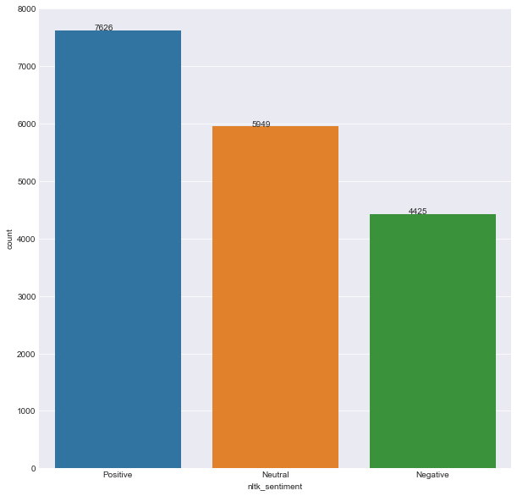

Slide 9
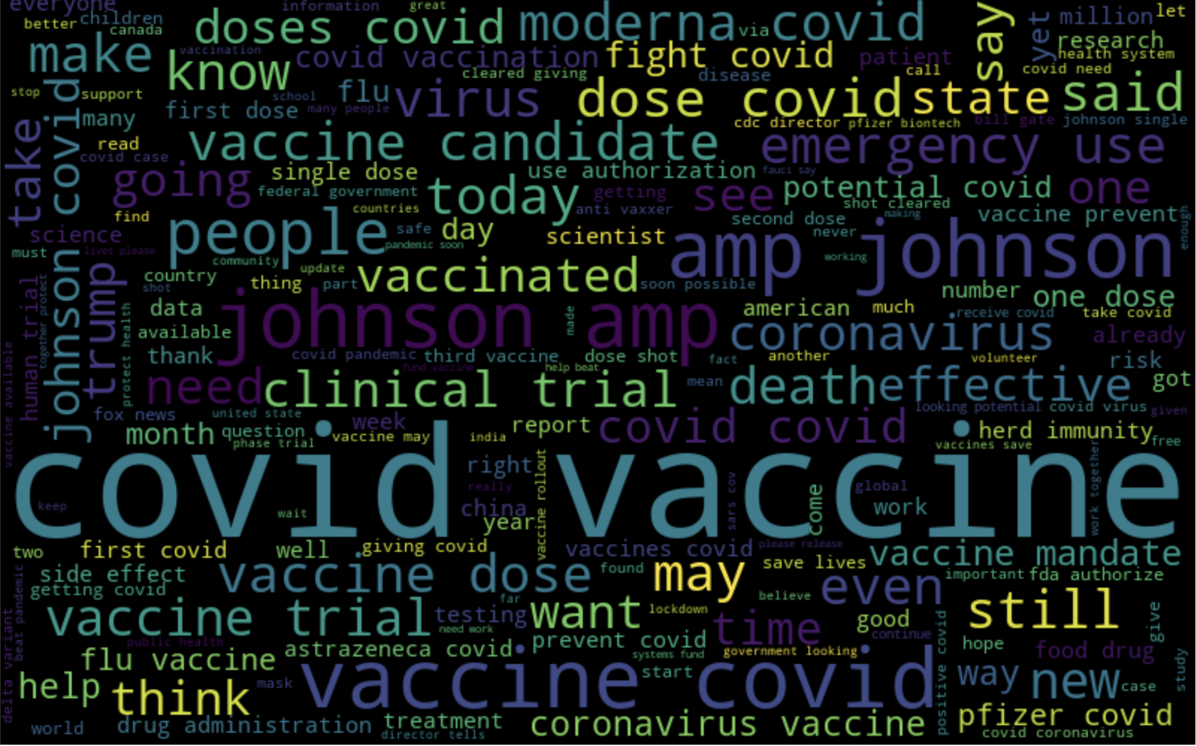

Slide 10
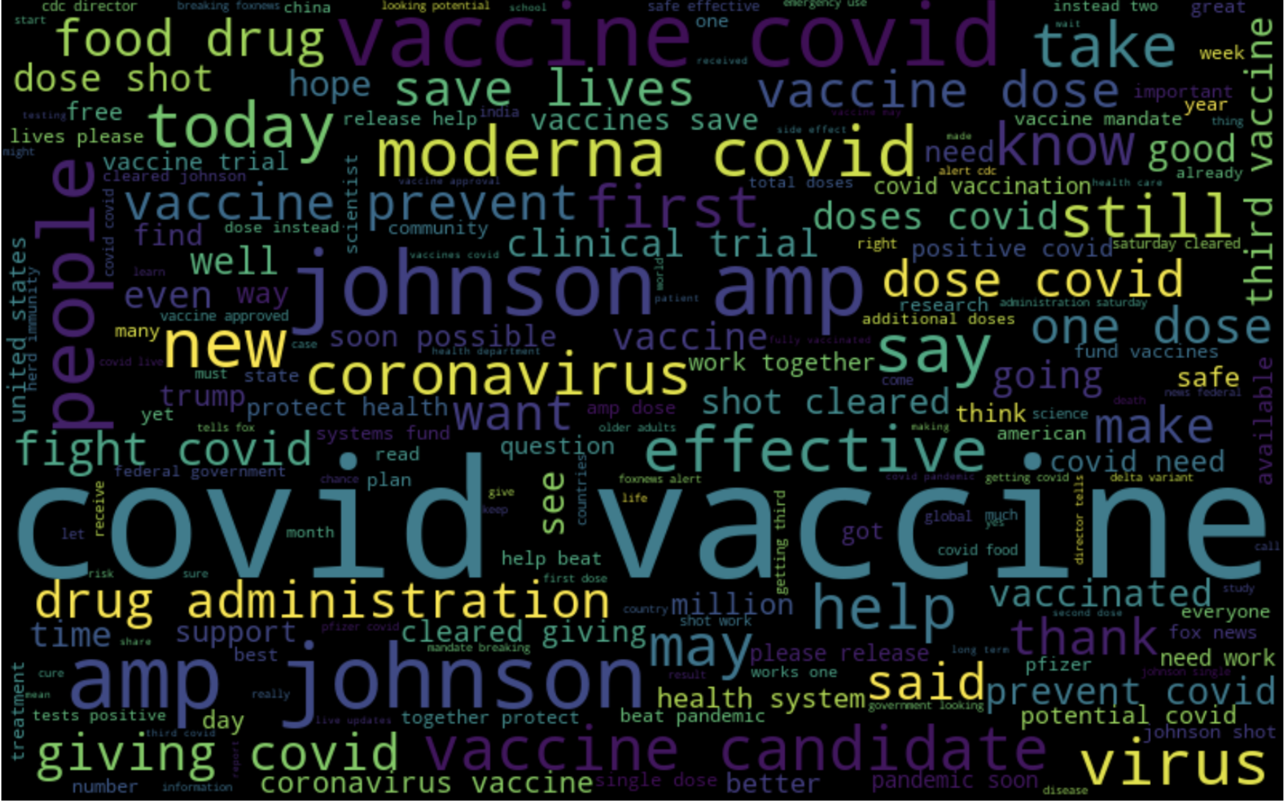

Slide 11
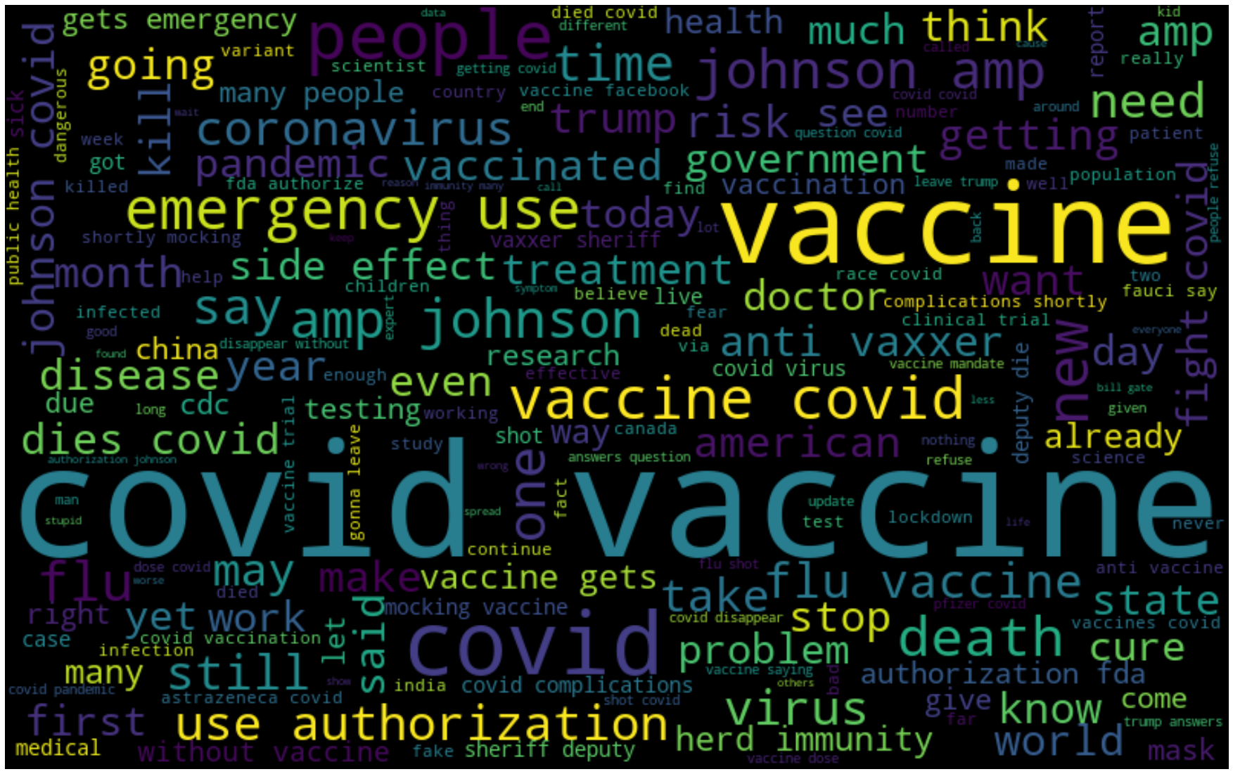
Notes:
@naidan dont forget “anti vaxxer”

Slide 12
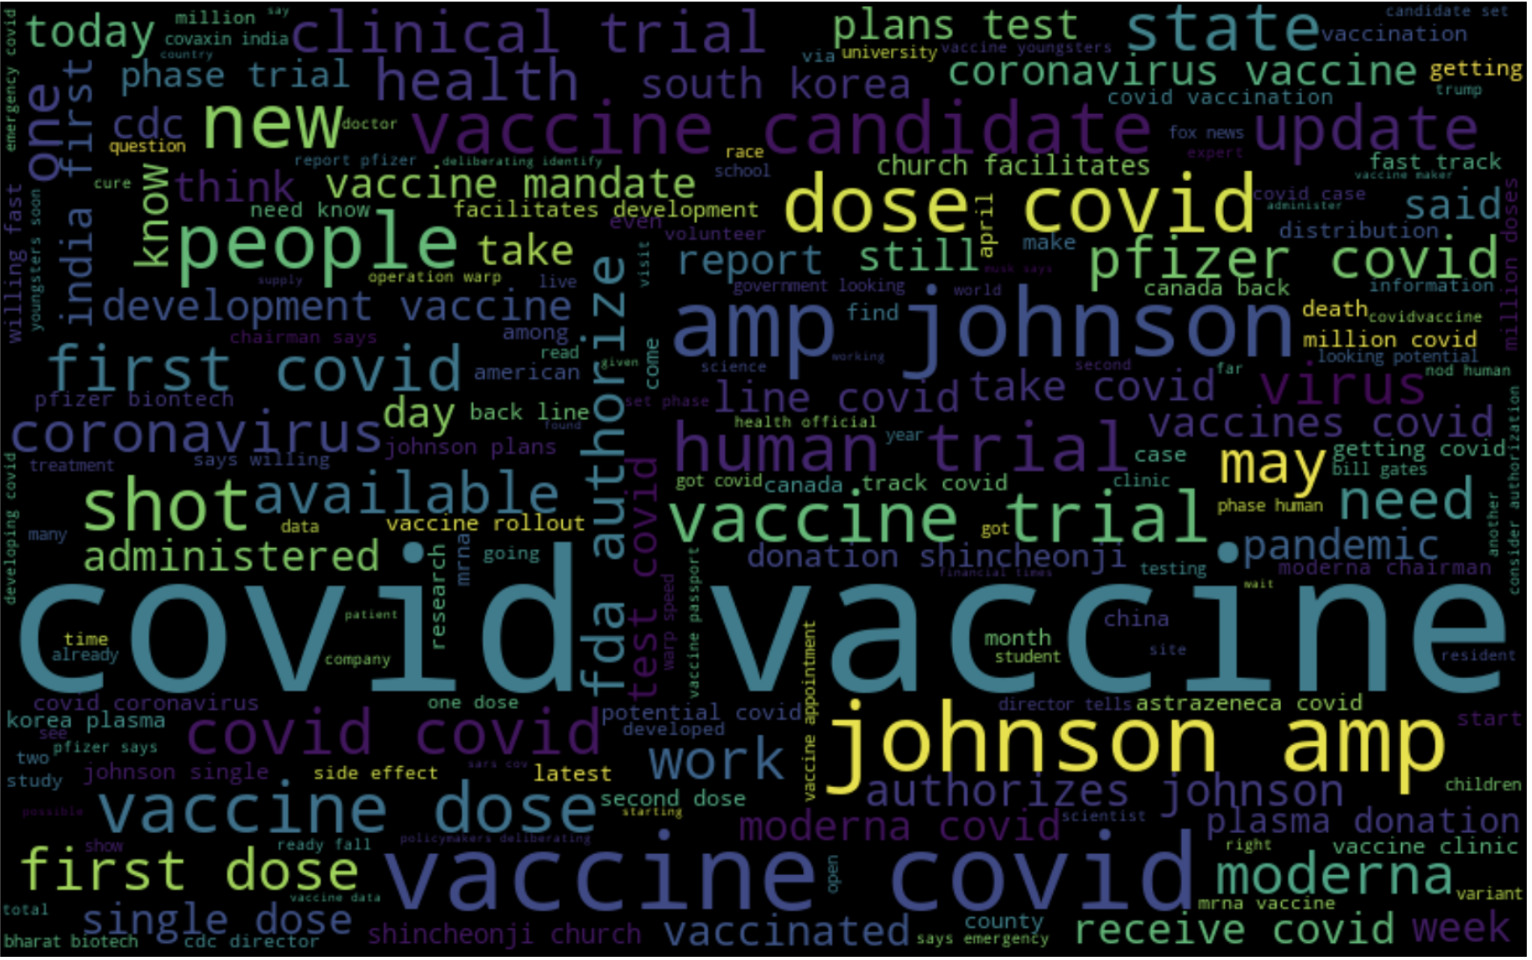

Slide 13
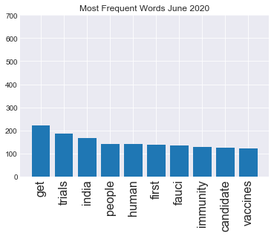
Notes:
Adam

Slide 14
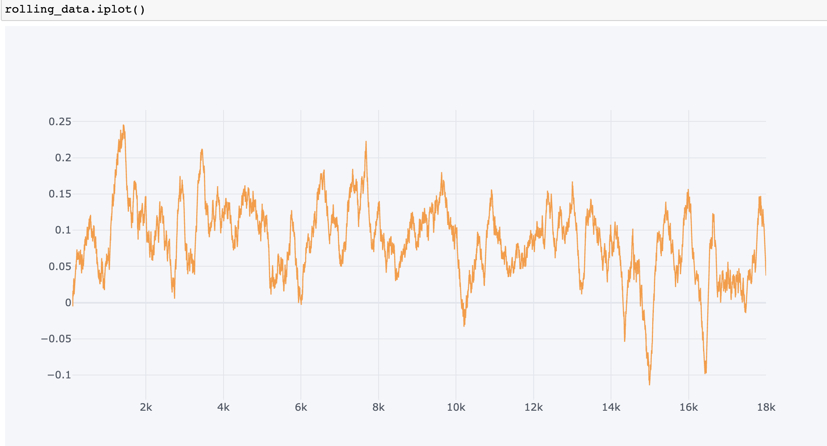
Notes:
Adam

Slide 15
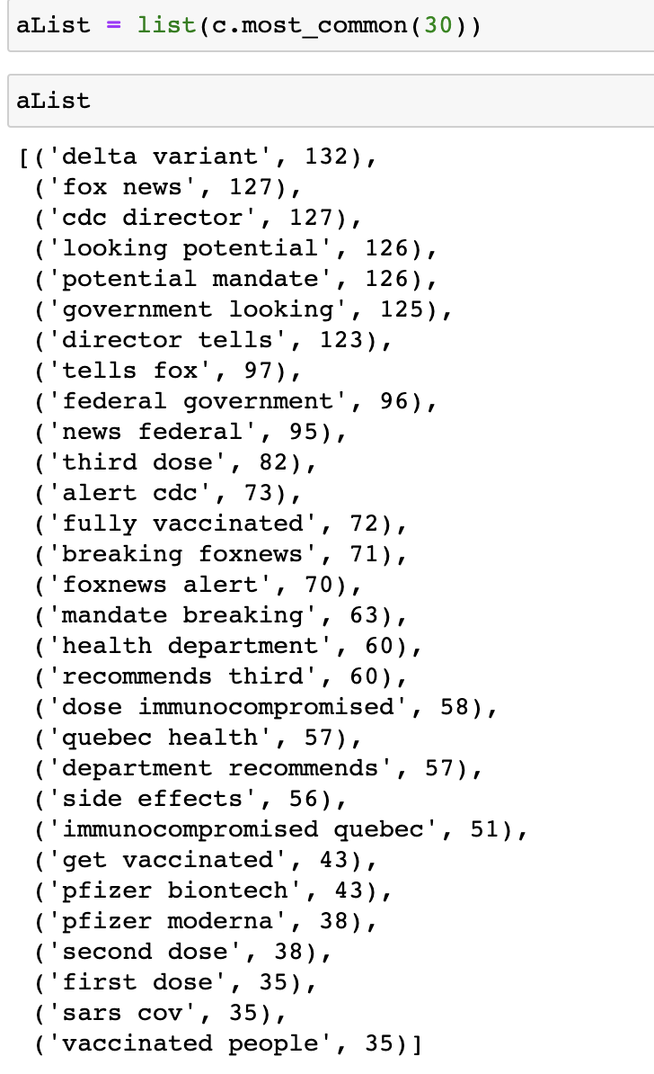

Slide 16
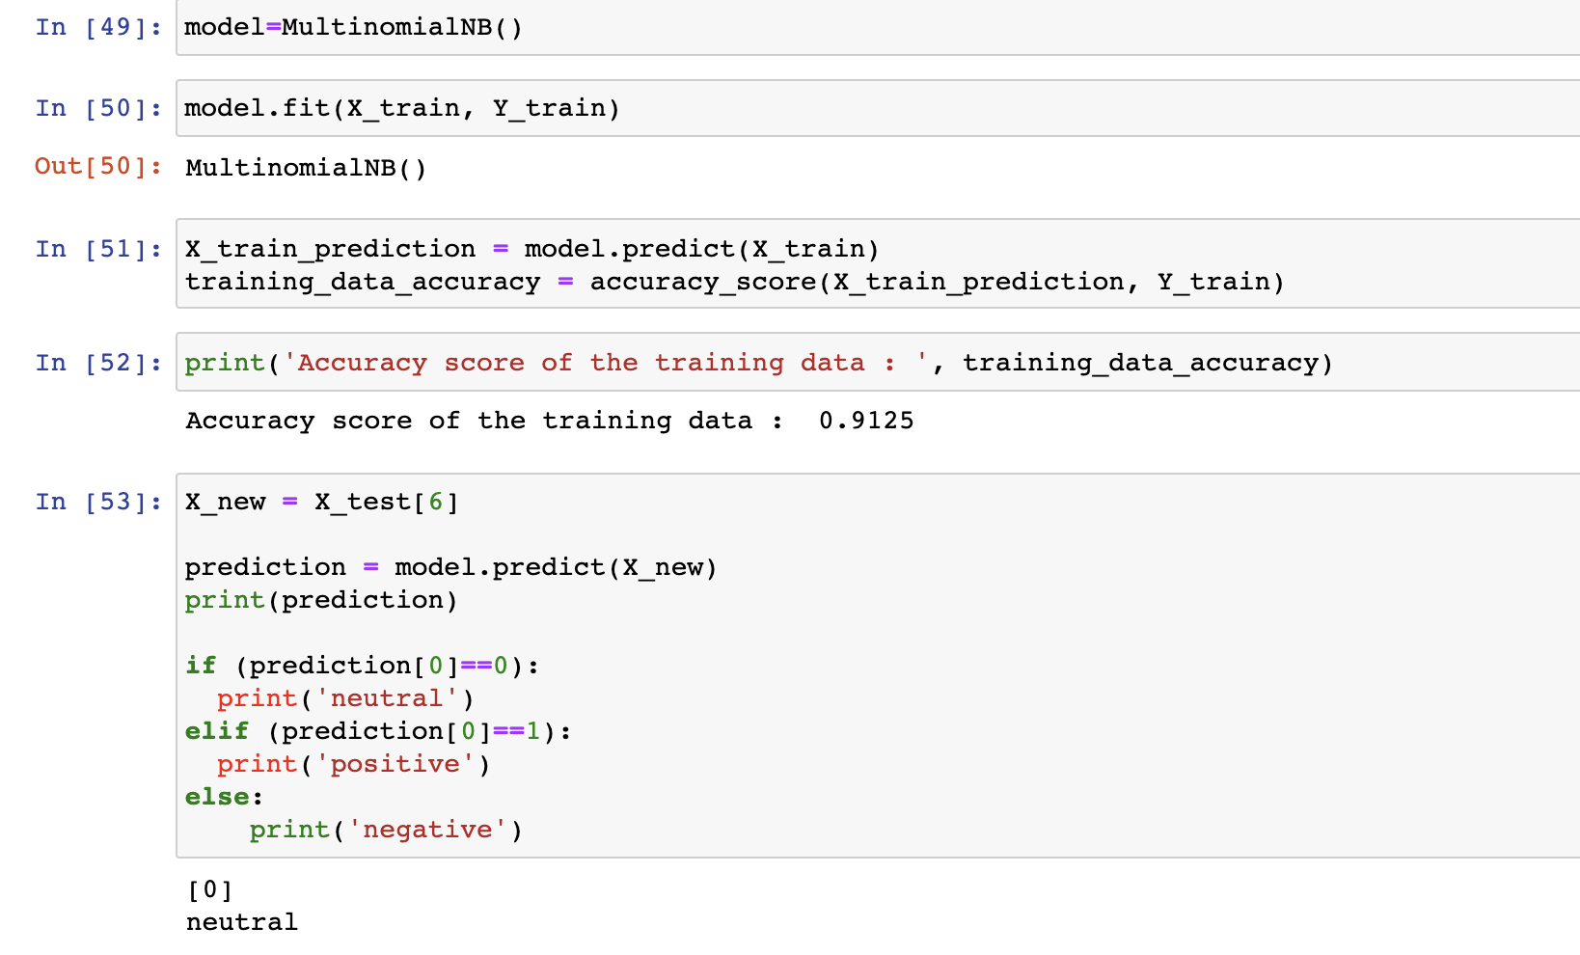
MultinomialNB classifier, its classification accuracy to our corpus is 91%
We initially chose MultinomialNB classifier and here are the results,

Slide 17
Future steps
Comparing various classifiers, based on their accuracies, false positives, false negatives and other metrics.
Training our model using bi-grams.
Work on re-sampling and a bootstrapped model, evaluating this model.
Work with sklearn pipeline to try out new methods like k-folds, cross validation using grid search cv.
Choosing the robust model to classify any new test sets.

Slide 18
Thank you!
.

